Slide 1
Diabetic Retinopathy
Past, Present and Future
Phoebe Mellen MD
Retina Vitreous Consultants

Slide 2
Financial Disclosures
Consultant for Gyroscope Therapeutics (not ongoing), Not relevant for this subject matter

Slide 3
Objectives
An overview of the pathophysiology of DR, and clinical staging criteria
current therapies and mechanism of action
clinical trials that help drive DR management decisions.
newer diabetes agents (specifically GLP-1 agonists) had any role in worsening or improving diabetic retinopathy.
future treatments/ treatments undergoing clinical trial with vision saving potential for our patients.

Slide 4
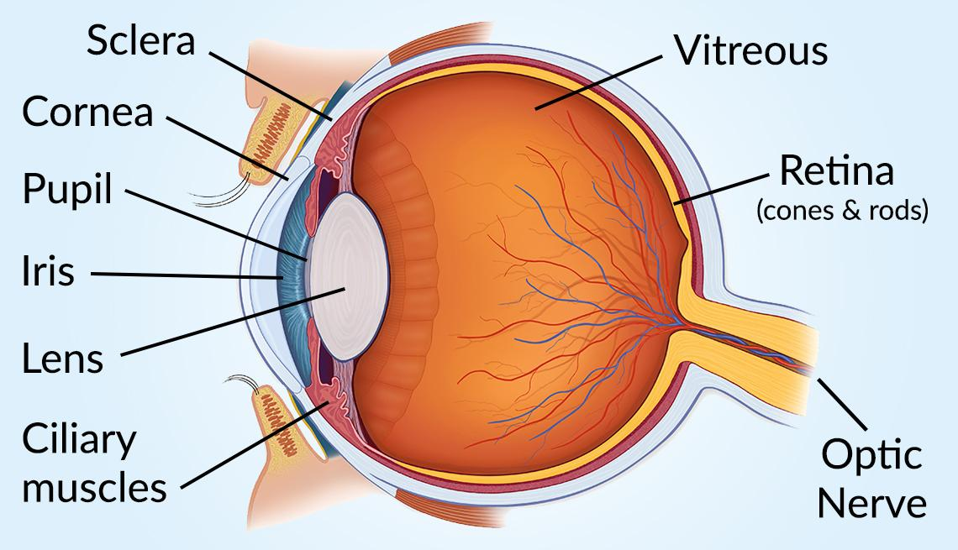
LAUREN SHAVELL / GETTY IMAGES /AARP, “ The eye and how we see” https://www.aarp.org/health/conditions-treatments/info-2020/eye-diagram.html
Notes:
First Id like to quickly review the anatomy of the eye
The retina is the most posterior portion of the eye, it is ten cell layers thick- those cells pick up light signal and turn it into an image which is then transmitted to the brain
Im going to focus on how diabetes effects the retina and management

Slide 5
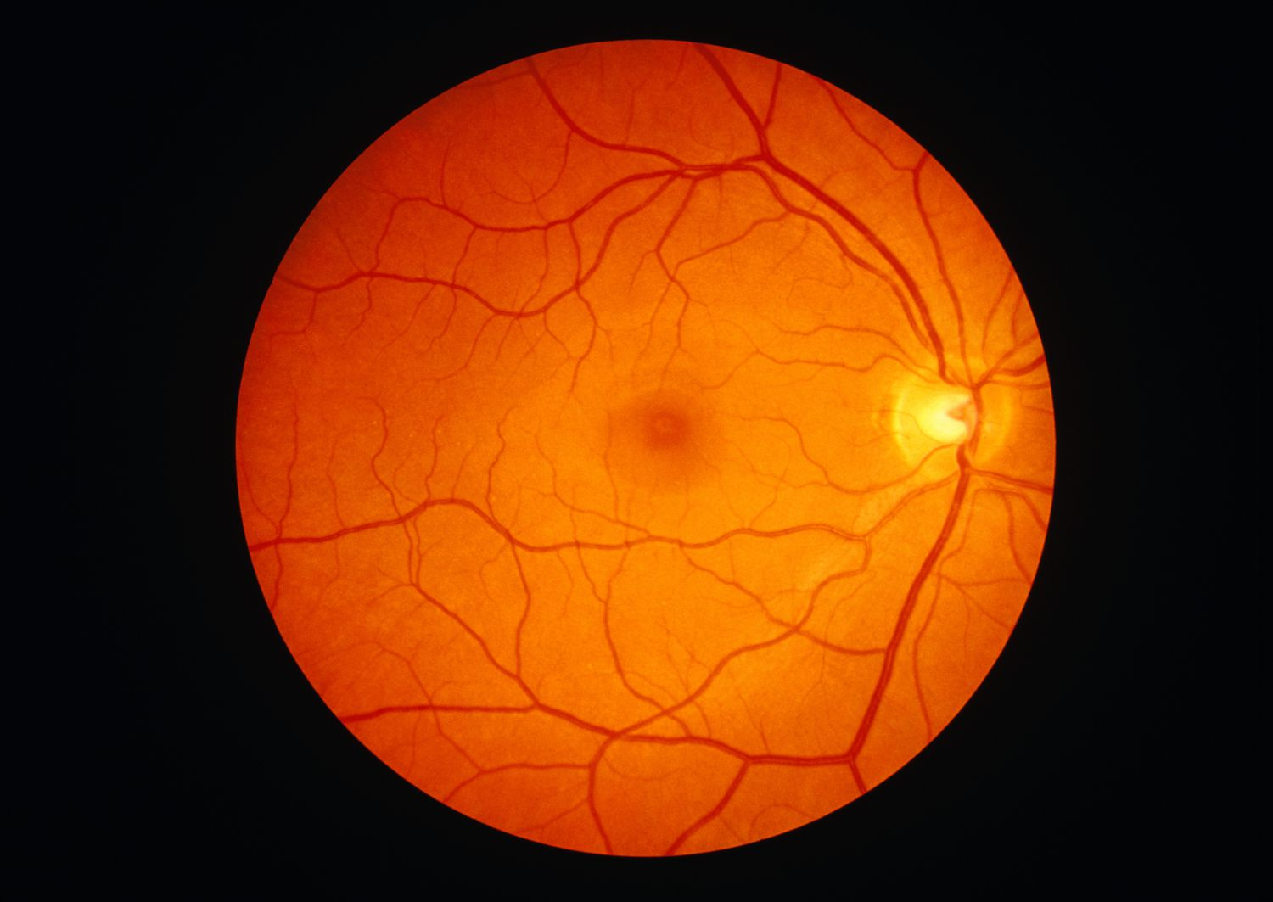
Notes:
Optic nerve
Vessels
Most importantly here is the macula- Fine vision, reading vision. These are the cells that read the eye chart. LOCATION LOCATION LOCATION

Slide 6
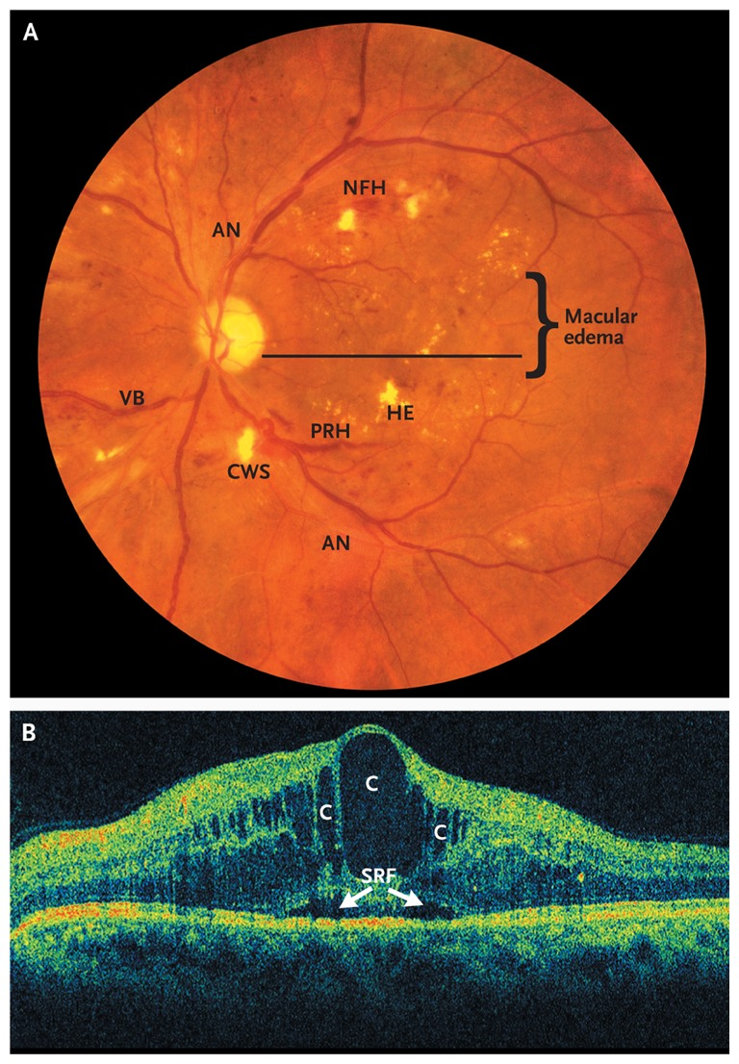
What is diabetic retinopathy?
Changes that occur in the retina from the effects of diabetes
Hemorrhages/ microaneurysms
Retinal infarcts (cotton wool spots)
Vascular abnormalities
Capillary Non perfusion
Macular edema
Neovascularization
Tractional retinal detachment
Antonetti DA, Klein R, Gardner TW. “Diabetic Retinopathy”. N Engl J Med 2012; 366 1227-1239
Notes:
NEJM Photo

Slide 7
Epidemiology of diabetic retinopathy (DR)
Leading cause of vision loss in Adults 20-74 yo.
2010: 285 million people with DM
Over ⅓ have Diabetic Retinopathy (DR)
⅓ have vision-threatening DR
Severe non-proliferative DR
Proliferative DR
Diabetic macular edema

Slide 8
Pathophysiology
Hyperglycemia induced vascular damage
Pericyte loss, loss of vascular integrity
Hyperpermeability
Microaneurysm formation
Endothelial cell death, BM thickening
Capillary occlusion
Ischemia
Ferland-McCollough D, Slater S, Richard J et al. Pericytes, and overlooked player in vascular pathobiology. Pharmacol Ther. 2017; 171:30-42
Notes:
David Ferland-McCollough, Sadie Slater, Jai Richard, Carlotta Reni, Giuseppe Mangialardi,, Pericytes, an overlooked player in vascular pathobiology,Pharmacology & Therapeutics, Volume 171,2017, Pages 30-42,

Slide 9
Staging of Diabetic Retinopathy
Non-proliferative diabetic retinopathy (asymptomatic)
Mild: microaneurysms only
Moderate
Severe : 4 quadrants of hemorrhages, Vascular anomalies
Proliferative diabetic retinopathy
Growth of new blood vessels within the retina (neovascularization)
Vitreous hemorrhage
Tractional retinal detachments
** at any point, diabetic macular edema can develop, causing decline in vision

Slide 10
Diabetic Macular Edema (DME)
retinal thickening due to an accumulation of intraretinal fluid
Leakage of fluid from hyperpermeable capillaries, leading to breakdown of the blood retinal barrier.
leading cause of vision loss in patients with diabetic retinopathy, affecting 2.7-11%.
Notes:
Lets define some terms first

Slide 11
Neovascularization
Retinal capillary drop out
Ischemic retina upregulates VEGF
New, fragile blood vessels and fibroblasts proliferate
PROLIFERATIVE DIABETIC RETINOPATHY

Slide 12
Vision Threatening Complications
Macular edema: swelling
Any Stage of Diabetic retinopathy
Vitreous hemorrhage
Tractional retinal detachments
Fibroblast contraction
End stage, required surgical intervention
High risk of permanent blindness or vision loss

Slide 13
Notes:
This is my exam,

Slide 14
Notes:
Highlights the impressiveness of the ischemia that occurs the microvascular changes that you can actually visualize. You ant look at the kidney and see the vascular changes, but with our imaing you can actually see and appreciate the degree of ischemia occurring

Slide 15
Notes:
Vitreous hemorrhage
Get absorbed over months
Limited patient ability to drive, work, function. Months to clear

Slide 16
Wisconsin ESDR:
Prevalance of Retinopathy (Type 1 DM)
3 Years: 8%
5 years: 25%
10 years: 60%
15 years: 80%
20% Proliferative Retinopathy
20 year Approach 100
Screening recommended: within 3-5 years of diagnosis, or at age 10
Type 2 Diabetics
21% have retinopathy at the time of DM diagnosis
Screening recommended: at diagnosis of diabetes
Notes:
Wisconsin epidemiologic study of DR

Slide 17
Screening guideline of Diabetic Retinopathy
Non-proliferative diabetic retinopathy (asymptomatic)
Mild: Annual exams
Moderate: q 6-9 months
Severe: q 3-4 months
Proliferative diabetic retinopathy
Treatment required
Follow up depends on treatment
Diabetic Macular edema: every 4 weeks

Slide 18
Risk factors: for vision loss
Duration
Hyperglycemia
Hypertension
Pregnancy!
Increased risk of development or retinopathy OR rapid progression
Limited options for treatment

Slide 19
Landmark trials
Diabetes Control and Complications Trial (DCCT) – 1993
Type 1 diabetics: randomized to tight glucose control ( infusion vs. 3+ injections) vs. Conventional control (2 injections)
showed that A1C ~ 7.0 reduced rates of complication (eye, kidney, neuropathy) by 60%
UK Prospective Diabetes Study
Type 2 diabetics: Supports intensive glucose control (Goal < 7) decreases complications
Hypertension control : tight control (<150/85) reduced risk of retinopathy by 34%
Each percentage point decrease in A1C: 35% reduction in microvascular complications
Notes:
The Diabetes Control and Complications Trial (DCCT) investigated the effect of hyperglycemia in type 1 diabetic patients, as well as the incidence of diabetic retinopathy, nephropathy, and neuropathy. A total of 1,441 patients who had either no retinopathy at baseline (primary prevention cohort) or minimal-to-moderate NPDR (secondary progression cohort) were treated by either conventional treatment (one or two daily injections of insulin) or intensive diabetes management with three or more daily insulin injections or a continuous subcutaneous insulin infusion. In the primary prevention cohort, the cumulative incidence of progression in retinopathy over the first 36 months was quite similar between the two groups. After that time, there was a persistent decrease in the intensive group. Intensive therapy reduced the mean risk of retinopathy by 76% (95% CI 62–85). In the secondary intervention cohort, the intensive group had a higher cumulative incidence of sustained progression during the first year. However, by 36 months, the intensive group had lower risks of progression. Intensive therapy reduced the risk of progression by 54% (95% CI 39–66).
The protective effect of glycemic control has also been for confirmed patients with type 2 diabetes. The U.K. Prospective Diabetes Study (UKPDS) demonstrated that improved blood glucose control reduced the risk of developing retinopathy and nephropathy and possibly reduces neuropathy. The overall rate of microvascular complications was decreased by 25% in patients receiving intensive therapy versus conventional therapy. Epidemiological analysis of the UKPDS data showed a continuous relationship between the risk of microvascular complications and glycemia, such that for every percentage point decrease in HbA_{1c} (e.g., from 8 to 7%), there was a 35% reduction in the risk of microvascular complications.

Slide 20
Panretinal Photocoagulation (PRP)
Diabetic Retinopathy Study (DRS). 1970
Patients with PDR or Severe NPDR: one eye was randomized to PRP, the other to observation
Photocoagulation reduces the risk of Severe vision loss (<20/200) by MORE THAN 50%
Remains a pillar of treatment today
Ablative laser to peripheral retina decreases VEGF drive
Decreased visual field
WORSEN macular edema
Decreased night vision

Slide 21
Notes:
Here you can see the laser marks, appreciate the amount ot retina that is treated

Slide 22
VEGF
vascular endothelial growth factor
diffuseable mitogen released by retinal pigment epithelium (RPE), Muller cells, and endothelial cells in response to hypoxic injury.
upregulating angiogenesis and leads to the development of new capillary networks, (neovascularization)
It also causes microvascular hyperpermeability, leading to macular edema.

Slide 23
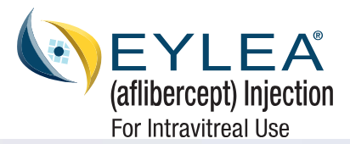
The Anti VEGF Era
*Avastin off label

Slide 24
Off Label (1.25 mg in 0.05mL)
Recombinant humanized monoclonal IgG1 molecule- Full antibody
Binds VEGF- A
First used in 2005
Bevacizumab (Avastin, Genentech, South San Francisco, CA)

Slide 25
Antibody fragment
Binds VEGF-A
( Genentech, Inc. San Francisco, CA),

Slide 26
Recombinant fusion protein, Human VEGF receptor 1 and 2, fused with Fc portion of IgG1
Binds VEGF A, VEGF B, PIGF
Superior results for DME
(Eylea, Regeneron,Tarrytown, NY)

Slide 27
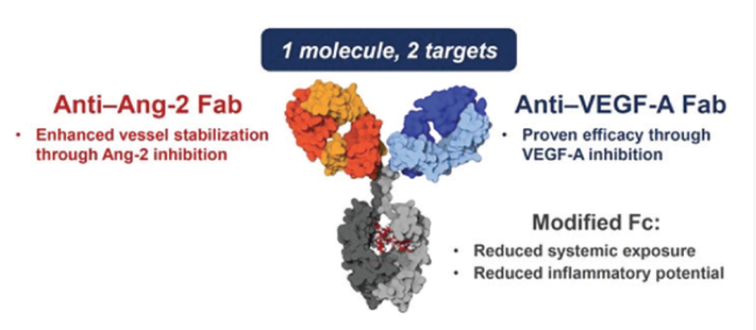
Bispecific antibody against VEGF-A and Angiopoeitin-2 (Ang-2)
Ang 2 causes microvascular inflammation/instability
(Genentech, Inc. San Francisco, CA),

Slide 28
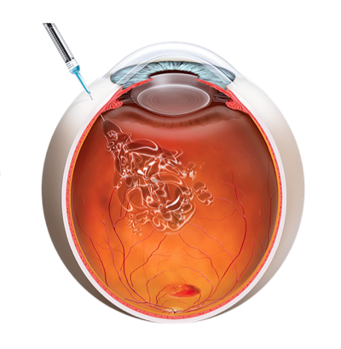
Procedure and Safety of Intravitreal injections
Most commonly performed ophthalmic procedure
2.4 million performed annually and growing
Expanding indications, new agents
Procedure
Safety:
Infection risk 0.019%- 0.07% ( less than 1:1000)
Retinal detachment < 1:7000
Intraocular inflammation (rare)
“intravitreal Injections” https://precisioneyeclinic.com.au/intravitreal-injections/ Access July 2023
Notes:
Overall these are very safe and very efficacious
The goal is to always make it SAFER and More effective

Slide 29
Downsides to Intravitreal injections
Psychological burden
Treatment burden
Q4 weeks for DME, years of treatment
Patient and families
Half life
Lack of durability
Q4-Q12 weeks

Slide 30
Lost to follow up study
59 patients with PDR lost to follow up for 6 months after treatment (Either Anti-VEGF, or PRP)
Anti-VEGF group upon return: worse vision, increased rate of tractional detachment, recurrent neovascularization
Highlights:
Lack of Durability (future directions)
Importance of compliance
Difficult in this population: significant comorbidities, number of appointments/ treatment burden, risk of hospitalizations

Slide 31
GLP-1 Receptor Agonist and Retinopathy
GLP-1 Receptor Agonists: Glucagon- Like peptide 1 Receptor Agonists
Incretins
Hormones secreted by intestinal cells upon food intake
Increases insulin production, decrease glucagon
Slow gastric emptying, Reduce appetite
Notes:
Marso SP, Bain SC, Consoli A, et al. Semaglutide and Cardiovascular Outcomes in Patients with Type 2 Diabetes. N Engl J Med. 2016;375(19):1834-1844. https://www.nejm.org/doi/10.1056/NEJMoa1607141
Hernández C, Bogdanov P, Corraliza L, et al. Topical Administration of GLP-1 Receptor Agonists Prevents Retinal Neurodegeneration in Experimental Diabetes. Diabetes. 2016;65(1):172-187. https://diabetesjournals.org/diabetes/article/65/1/172/34979/Topical-Administration-of-GLP-1-Receptor-Agonists

Slide 32
SUSTAIN 6 Results
SUSTAIN 6 results: semaglutide
Improved cardiovascular effects
Vs Placebo: less risk of nonfatal MI, nonfatal stroke, and cardiovascular death
Rapid worsening of diabetic retinopathy (vision threatening complications)
Hazard ratio of 1.76
Why? Unclear. Large/rapid drop in A1C
Synergy between VEGF and the drug molecule itself; rapid osmotic shifts
Conflicting analyses: we just don’t know!

Slide 33
FOCUS Study
FOCUS STUDY
5 years: randomized, placebo controlled study looking at DR progression in patients with Semaglutide vs. Placebo
Primary outcome: 3 step level progression/worsening of DR
Bottom Line: Systemic health/control trumps controversial ocular effects
doesn’t impact management much
Regular follow up is key, early intervention with Anti-VEGF

Slide 34
Pregnancy and Retinopathy
Risk of progression during pregnancy (Diabetes in Early Pregnancy Study- DIEP)
Mild: 21.1%
Mod-severe: 54.8%
RF: Poor control at conception, duration of DM, and Hypertension
Does not effect long term retinopathy
Typically regresses after pregnancy
Patients should be seen prior to conception, q3 months during pregnancy
NOT gestational DM

Slide 35
Pregnancy and Retinopathy
Hypothetical risk to Fetus with Anti-VEGF
Category C
VEGF plays a roll in placental and fetal vasculature
Decreased VEGF associated with pregnancy loss
Steroids and Laser are mainstay of treatment
Refer patients considering pregnancy sooner, to control eye disease earlier

Slide 36
Future Directions
Improving durability of Anti-VEGF Agents
lessen treatment burden

Slide 37
Future Directions- Current Trials
EYP-1901 (Phase 2)
vorolanib in a single 6 month injection (Bio-erodable insert)
Tyrosine Kinase Inhibitor- blocks all isoforms of VEGFR

Slide 38
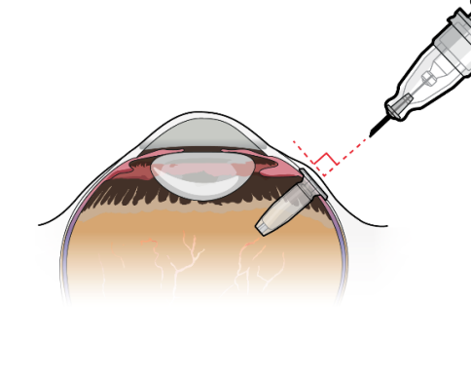
Future Directions- Current Trials
Port Delivery System: PAGODA Trial
Ranibizumab delivered through port delivery system, refill q 24 weeks
Phase 3 trial: non inferior to Ranibizumab intravitreal injections q4 weeks for DME
( Genentech, Inc. San Francisco, CA),

Slide 39
Future Directions: gene therapy
Introduction of genetic material into human cells, via viral vector
Eye is immune-privileged, blood retinal barrier
Vector introduction of anti-angiogenic molecules
Ranibizumab like protein
FLT1 gene: VEGF Receptor molecule (Decoy receptor)
ADVM (Adverum biotechnologies): AAV, Aflibercept
SiRNA: inference RNA- bind to VEGF mRNA, cause degradation , prevent protein formation

Slide 40
Summary
There is TONS of data on treatment for DR and DME, but it still remains the leading cause of vision loss in working age population
Mainstay of prevention: Tight glucose control, Blood pressure control.
Anti-VEGF has revolutionized this field, but it has limitations, and is very burdensome on patients
Lost to follow up can lead to vision loss, which can be permanent- compliance is paramount.
Future: Lots of research, prevent vision loss and decrease burden on patients.

Slide 41
Thank you!
Aiello LP, Avery RL, Arrigg PG, et al. Vascular endothelial growth factor in ocular fluid of patients with diabetic retinopathy and other retinal disorders. N Engl J Med 1994;331:1480–1487.
Amoaku WMK, Saker S, Stewart EA. A review of therapies for diabetic macular oedema and rationale for combination therapy. Eye (Lond) 2015;29:1115–1130.
Antonetti DA, Klein R, Gardner TW. “Diabetic Retinopathy”. N Engl J Med 2012; 366 1227-1239
Browning DJ, Stewart MW, Lee C. Diabetic macular edema: Evidence-based management. Indian J Ophthalmol 2018;66:1736–1750.
Diabetes Control and Complications Trial Research Group. Effect of pregnancy on microvascular complications in the diabetes control and complications trial. The Diabetes Control and Complications Trial Research Group. Diabetes Care. 2000;23((8)):1084–91.
Cai J, Boulton M. The pathogenesis of diabetic retinopathy: old concepts and new questions. Eye 2002;16:242–260.
Ferland-McCollough D, Slater S, Richard J et al. Pericytes, and overlooked player in vascular pathobiology. Pharmacol Ther. 2017; 171:30-42
Kim EJ, Lin WV, Rodriguez SM, et al. Treatment of Diabetic Macular Edema. Curr Diab Rep 2019;19:68.
Klein R, Knudtson MD, Lee KE, et al. The Wisconsin Epidemiologic Study of Diabetic Retinopathy XXIII. The Twenty-Five-Year Incidence of Macular Edema in Persons with Type 1 Diabetes. Ophthalmology 2009;116:497–503.
Lee R, Wong TY, Sabanayagam C. Epidemiology of diabetic retinopathy, diabetic macular edema and related vision loss. Eye Vis (Lond) 2015;2:17.
Mallika PS, Tan AK, Aziz S et al. Diabetic retinopathy and the effect of Pregnancy. Malays Fam Physician. 2010; 5(1):2-5
Marso SP, Bain SC, Consoli A, et al. Semaglutide and Cardiovascular Outcomes in Patients with Type 2 Diabetes. New England Journal of Medicine 2016;375:1834–1844.
Moshfeghi A, Garmo V, Sheinson D, et al. Five-Year Patterns of Diabetic Retinopathy Progression in US Clinical Practice. Clin Ophthalmol 2020;14:3651–3659.
Polizzi S, Mahajan VB. Intravitreal Anti-VEGF Injections in Pregnancy: Case Series and Review of Literature. J Ocul Pharmacol Ther 2015;31:605–610.
Royle P, Mistry H, Auguste P, et al. The landmark trials: Diabetic Retinopathy Study and Early Treatment Diabetic Retinopathy Study. In: Pan-retinal photocoagulation and other forms of laser treatment and drug therapies for non-proliferative diabetic retinopathy: systematic review and economic evaluation. NIHR Journals Library; 2015. Available at: https://www.ncbi.nlm.nih.gov/books/NBK305100/ [Accessed July 18, 2023].
Yoshida Y, Joshi P, Barri S, et al. Progression of retinopathy with glucagon-like peptide-1 receptor agonists with cardiovascular benefits in type 2 diabetes – A systematic review and meta-analysis. Journal of Diabetes and its Complications 2022;36:108255.

