Slide 1
Integrating Diabetes Technology with Inpatient Care
the Future is Now
Joseph A. Aloi MD, FACE, FACP
Chief: Section on Endocrinology & Metabolism
Enterprise Leader Research and Academics for Diabetes

Slide 2
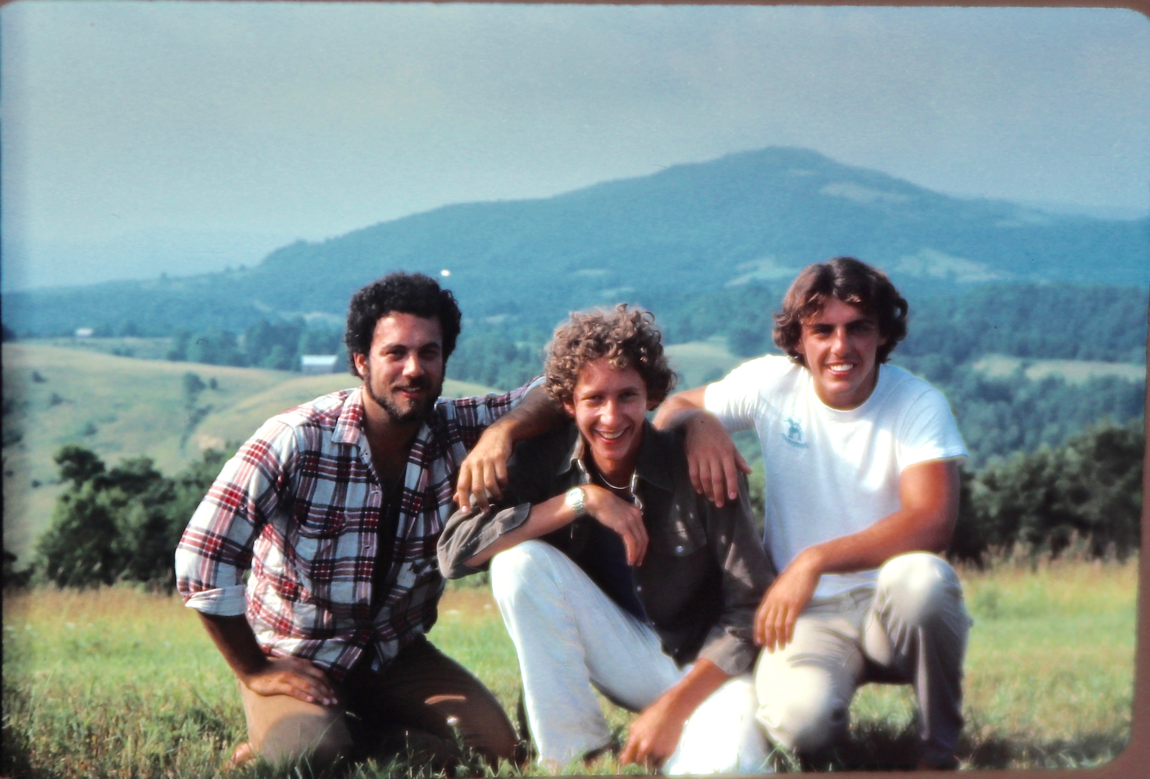
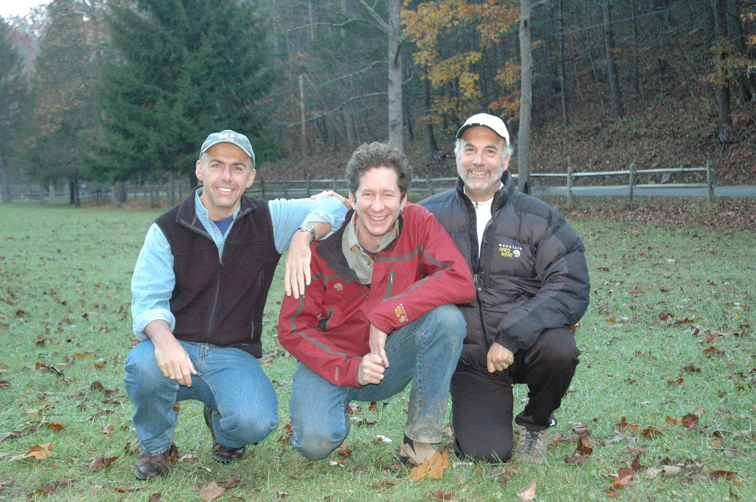
Disclosures
J. Aloi discloses that he receives research support from Abbott Diabetes and Medtronic Diabetes
@Josephaloi

Slide 3
Outline for Discussion
Anchor the audience to the problem
Brief history of diabetes management
Primarily focus on Continuous Glucose Monitors (CGM)
Insulin Automated delivery
Insulin dosing applications
Discuss solutions
Share recent WFBMC data
Inpatient use of CGM
Share Data from our first 200 patients using EndoTool

Slide 4
Drivers of Healthcare
2/3 of adult population are either overweight or obese
> 50% of adolescents DXd with DM will have complications of DM by age 30
1/3 Medicare dollars on Diabetes Mellitus
> 50% of the Medicare population have pre-diabetes
Less than half of adults with DM in USA are meeting core metrics for DM control (ABCs)

Slide 5
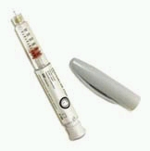
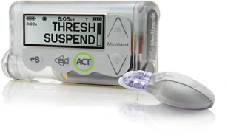
Major Diabetes Milestones
1552 BC Diabetes in Egypt
1800 Scientific method
1869 Langerhans identifies pancreatic cells
1944 Standard syringe
1921 Insulin discovered
1922 Clinical success
1955 Oral agents
1970 Insulin pump
2016-2022 HCL and AID
Professional CGM June 1999
1986 Insulin pen
1990s
HGM
2000s
CGMS

Slide 6
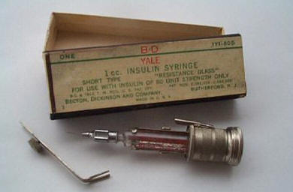
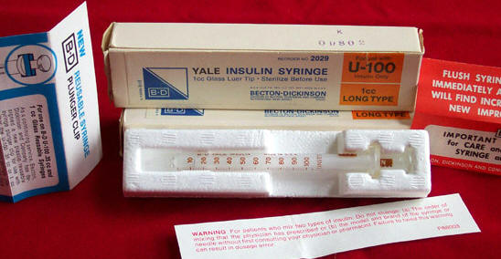
Early syringes were glass and needles were sharpened by user

Slide 7
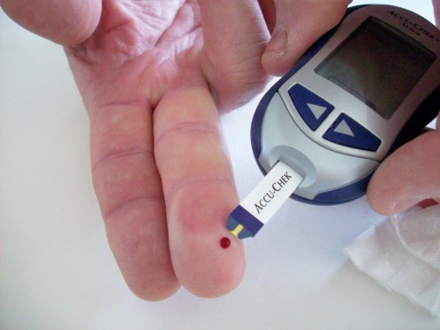
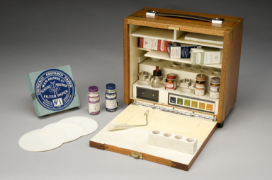
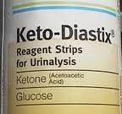
Early testing options

Slide 8
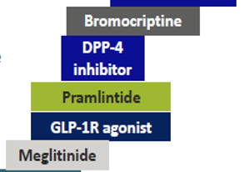
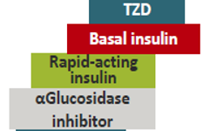
100 Years of Insulin
2017‒2018, only 75% of US adults with diagnosed diabetes met care goals for hemoglobin
A1C <8% CDC's Morbidity and Mortality Nov 9, 2020
GLP +GIP
Finger stick BG 1971-1980
2004-2006 Personal CGM
Chlorpropamide
Metformin
1920
1960
2000
2022

Slide 9
What is the Gap
?
Data to guide Therapy?

Slide 10
Hba1c does not tell the full story!
An A1c of 7% = average blood glucose of 154 mg/dl
Range | Example 1
< 70 mg/dl | 8%
70-180 mg/dl | 63%
> 180 mg/dl | 29%
Approximate A1c | 7.0%
Example 2
24%
18%
58%
7.0%
Example 3
-
100%
-
7.0%
But time in range – and thus ‘quality of A1c’ – can be dramatically different!
Source: Dr. David Nathan et al., Diabetes Care 2008

Slide 11
Example 1 – Hba1c of 7%
https://professional.diabetes.org/diapro/glucose_calc

Slide 12
Example 2 – Hba1c of 7%
https://professional.diabetes.org/diapro/glucose_calc

Slide 13
Example 3 – Hba1c of 7% eAG = 154 mg/dL
https://professional.diabetes.org/diapro/glucose_calc

Slide 14
CGM 101
wireless monitor, often called a receiver
transmitter
sensor
Thin as a human hair and about 1/4 inch long
uses the same enzyme to measure glucose levels as a test strip: glucose oxidase (glucose to hydrogen peroxide~~platinum inside the sensor)
Implantable Eversense sensor uses Fluorescence to detect glucose

Slide 16
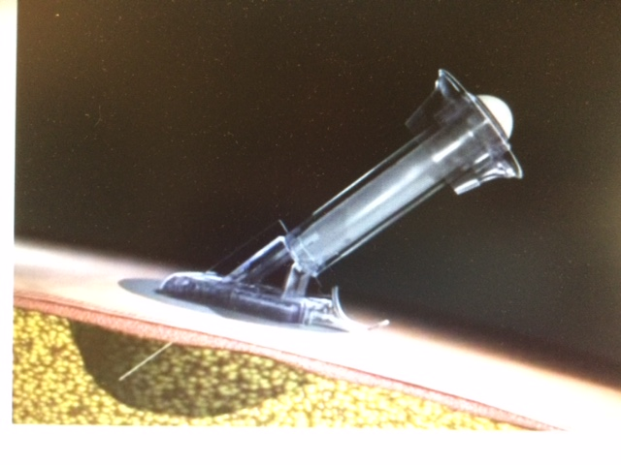
Sensor in SQ Space

Slide 17
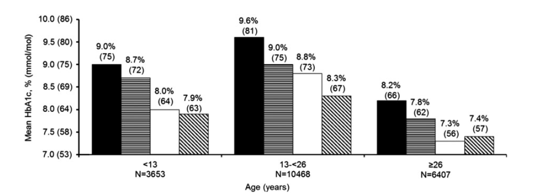
Why Diabetes Technology?
Improved glycemic control
Reduction in hypoglycemia
More information on daily fluctuations
Potential improvement in quality of life
No pump, no CGM
Pump
Injections
CGM
Pump
Pump + CGM
CGM
Pump + CGM
Foster et al. Diab Tech. Ther. 2019,
DOI: 10.1089/dia.2018.0384

Slide 18
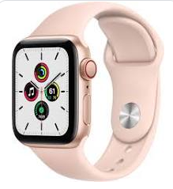
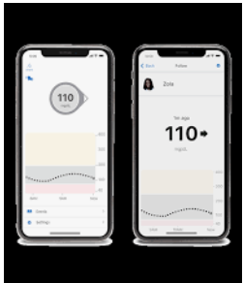
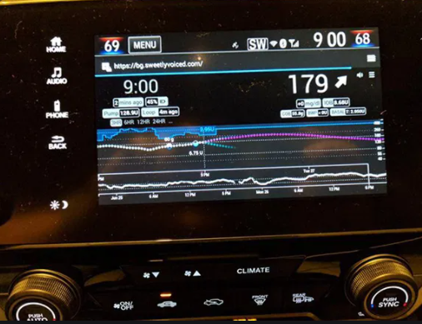
Bluetooth allows “pairing”

Slide 20
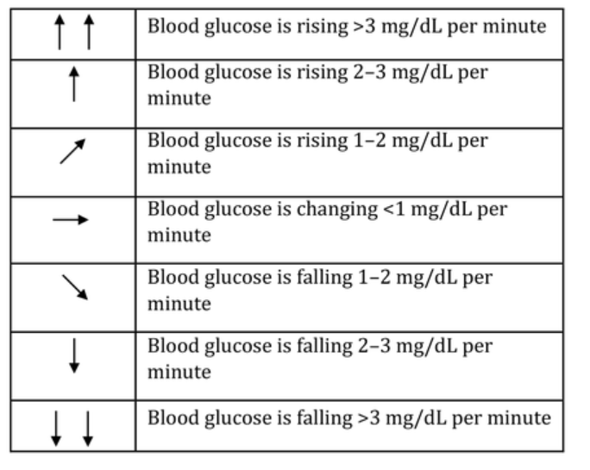
The Trend Is Most Important
Diabetes Spectrum 2019 Aug; 32(3): R.Longo and S. Sperling 183-193.

Slide 22
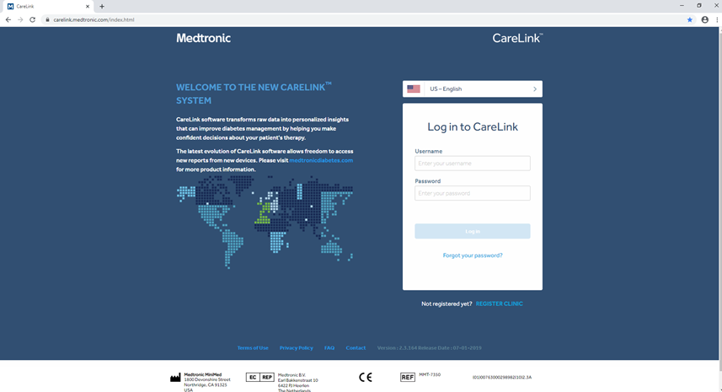
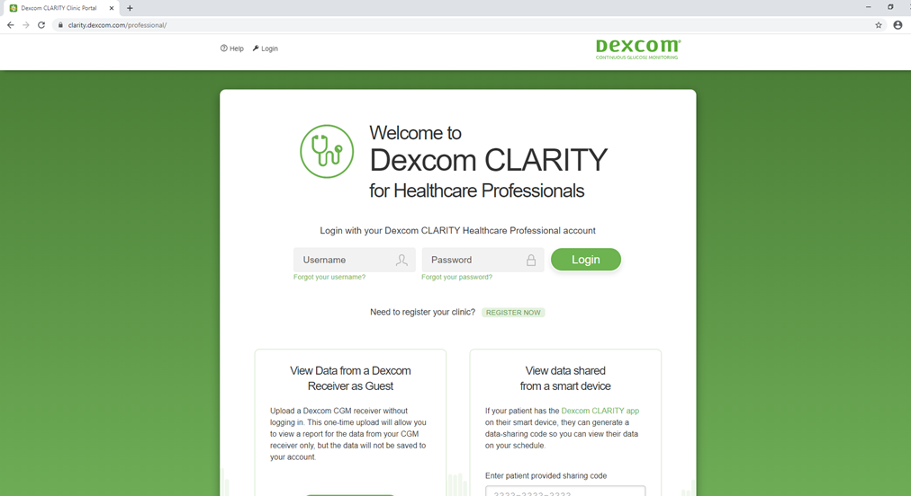
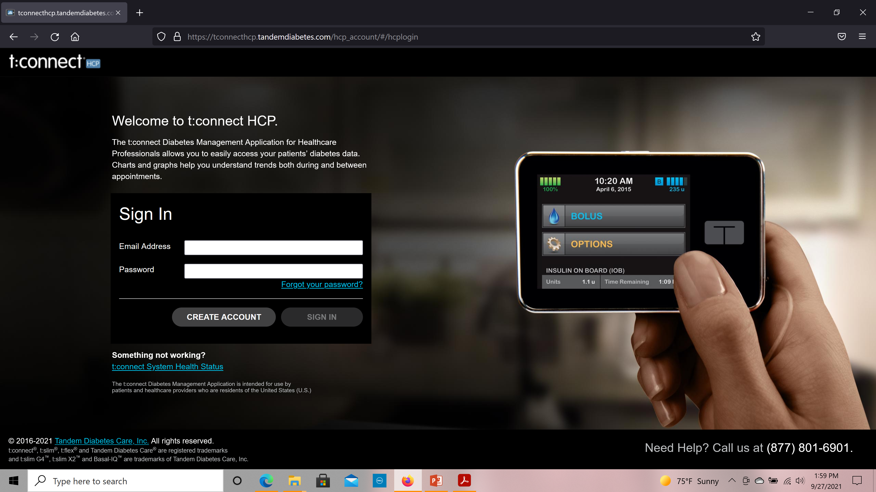
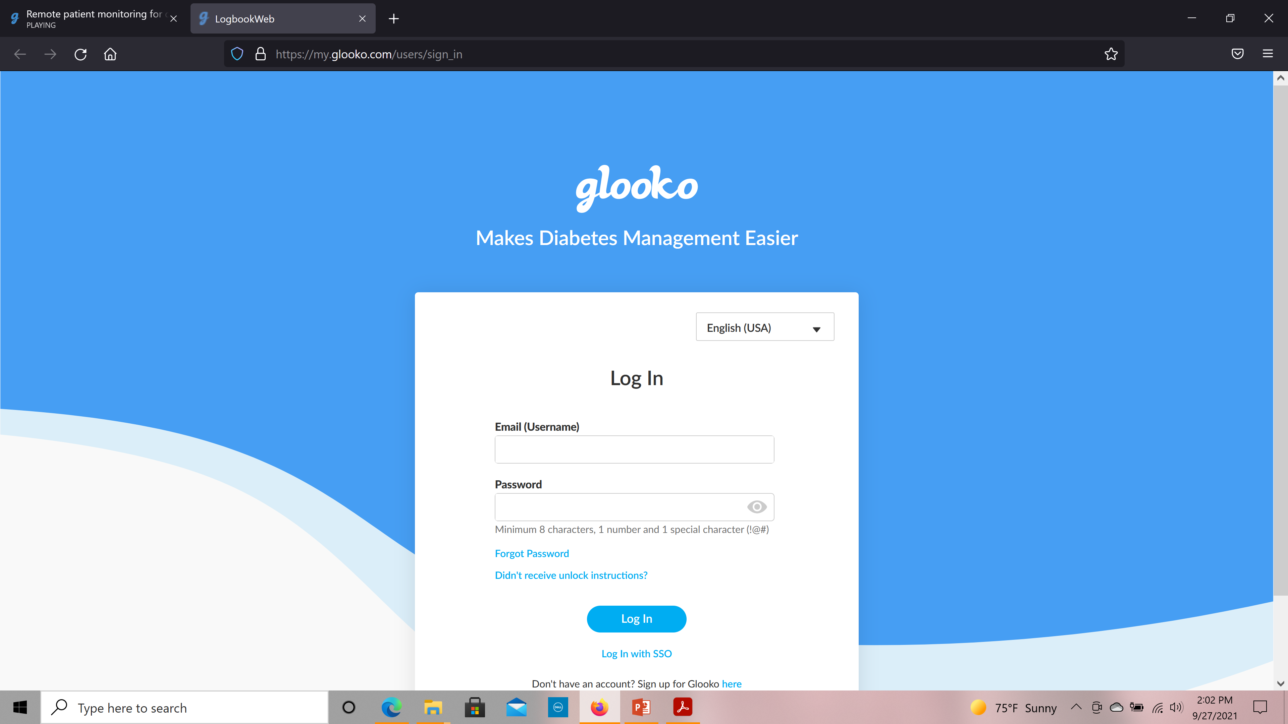
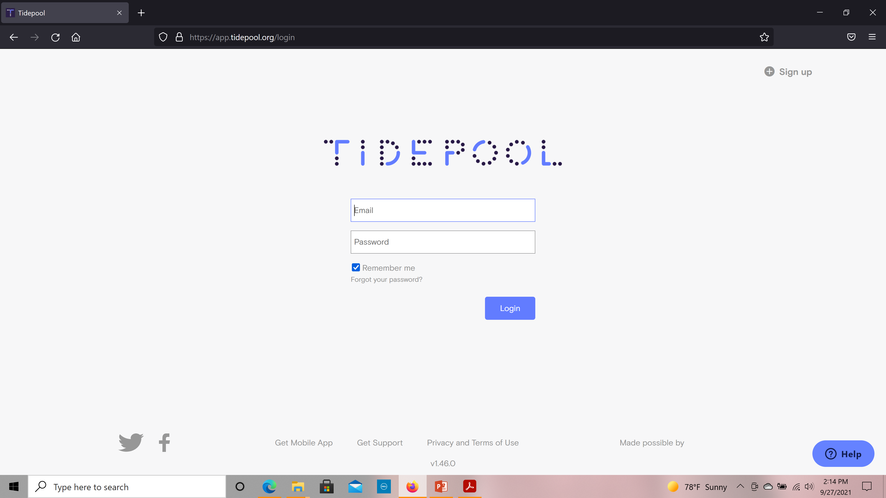
Diabetes Technology Software

Slide 25
2022 ADA Standards of Care
The phrase “CGM devices are a useful tool…” changed to:
RT-CGM) (A) or IS-CGM (B) should be offered for diabetes management in adults with diabetes on MDI or CSII who are capable of using devices safely.
We also highlight the choice of the device and importance of choosing the CGM with the appropriate features for the patient:
"The choice of device should be made based on patient circumstances, desires, and needs."
Source: Anne Peters ADA Standards of Care presentation

Slide 26
2022 ADA Standards of Care
Specific recommendations for CGM use in people using basal insulin are strengthened:
RT-CGM (A) or IS-CGM (C) can be used for diabetes management in adults with diabetes on basal insulin who are capable of using devices safely (either by themselves or with a caregiver).
Specific recommendations for youth:
RT-CGM (B) or IS-CGM (E) should be offered for diabetes management in youth with T1D on MDI or continuous subcutaneous insulin infusion who are capable of using the device safely.
Source: Anne Peters ADA Standards of Care presentation

Slide 27
2022 ADA Standards of Care
Former recommendations stated: Insulin pump therapy “may be” used.
Automated Insulin Delivery (AID) is strongly recommended as most effective treatment option for managing T1D and is placed first in the list of treatment options.
Source: Anne Peters ADA Standards of Care presentation

Slide 28
Good morning Dr. Aloi,
I have a reported hypoglycemic event to share. Event is pasted below. Patient was a 53 yo male admitted on 1/5 for GI bleed and the other following problems outlined in H&P: Type 2 diabetes, uncontrolled – HbA1c 11.3; alcoholic cirrhosis; acute on chronic kidney disease stage IV; chronic pancreatitis. He was seen by GMT yesterday for continued hyperglycemia during his stay and the following recs were made yesterday afternoon:
Continue FSBS AC and HS
- Increase Lantus 20 units daily.
- Start Prandial Lispro 6 units TID PC based on % of meal consumed

Slide 29
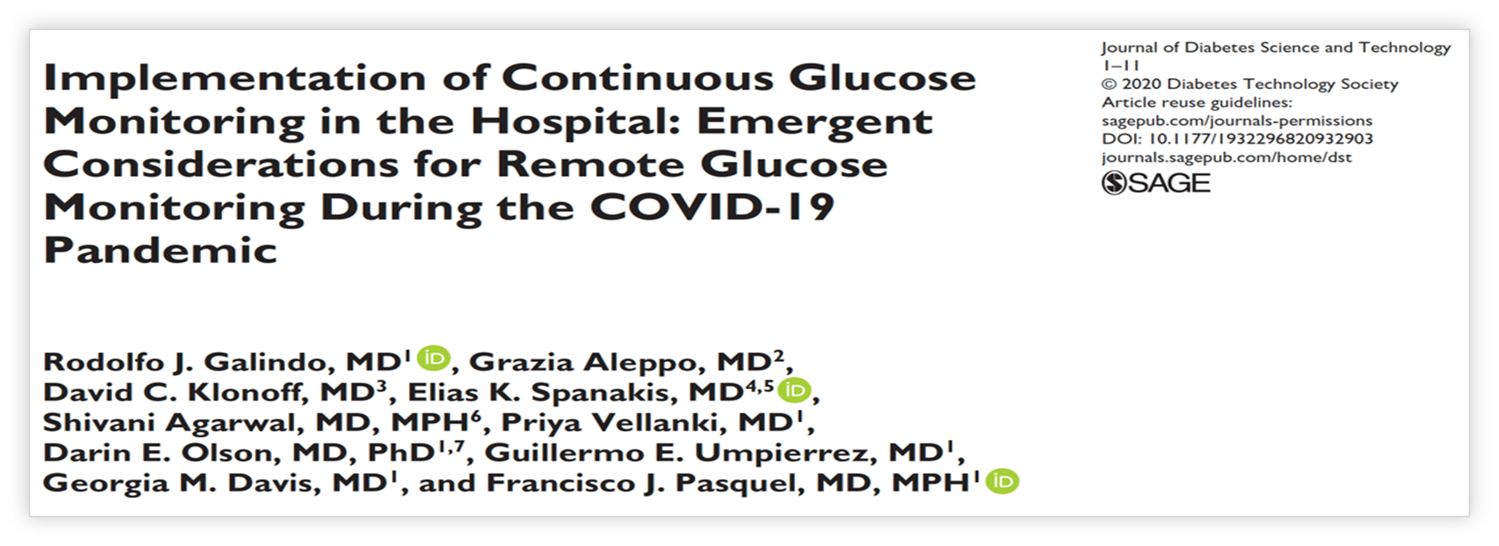
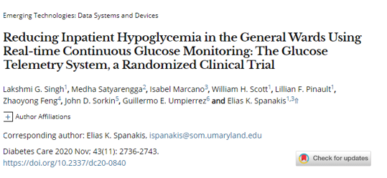
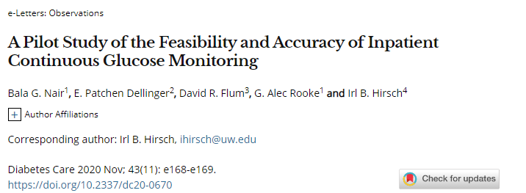
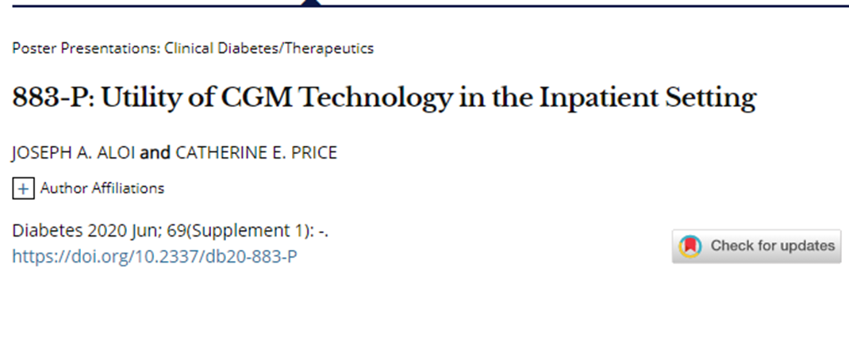
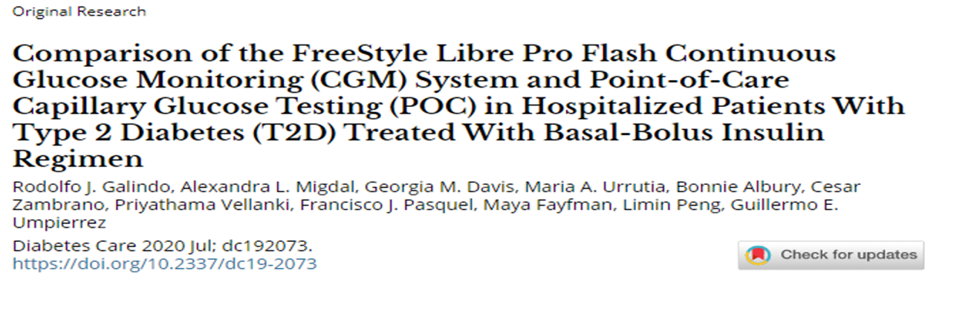
A Brief History of Inpatient CGM

Slide 30
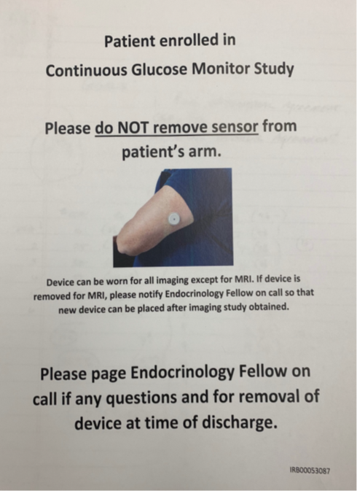
Inpatient observational CGM
What is the problem we are trying to address ?
Difficulties obtaining optimal inpatient glycemic management
What did we propose ?
20 patients DKA treated with IVI and 20 patients treated with BBT
Use blinded CGM to assess the concordance of CGM with Point of Care(POC) BG
Did it make a clinical difference
Did it create patient care barriers ( Nursing, Radiology, OR etc.)
Patient acceptance
IRB and IFC
Funded by a Learning Healthcare System Grant
Price C, Ditton G, Russel G, l et al: Reliability of Inpatient CGM: Comparison to Standard of Care. JDST 2021 doi.org/10.1177/19322968211062168

Slide 31
DKA Subject 2
Price C, Ditton G, Russel G, l et al: Reliability of Inpatient CGM: Comparison to Standard of Care. JDST 2021 doi.org/10.1177/19322968211062168

Slide 32
DKA Subject 2
Transition from IVI to BBT
Price C, Ditton G, Russel G, l et al: Reliability of Inpatient CGM: Comparison to Standard of Care. JDST 2021 doi.org/10.1177/19322968211062168

Slide 33
Pilot Trial of CGM Technology in the Perioperative Period
Adult patients with hyperglycemia and/or DM undergoing surgery of at least 3 hours received either a Freestyle Libre 2.0 CGM or Dexcom G6 CGM.
Price C, et al prelim data under review

Slide 34
Peri-op continued
Price C, et al prelim data under review

Slide 35
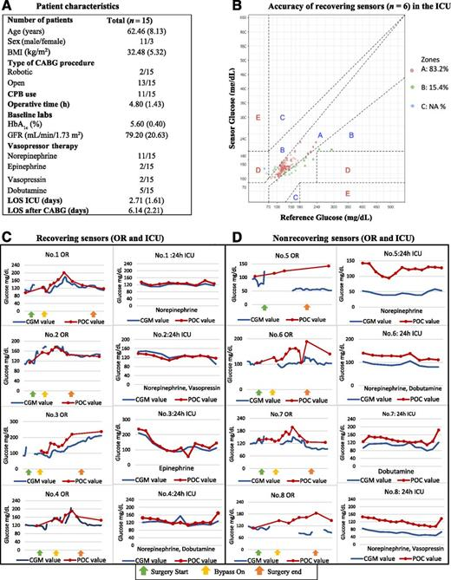
CGM reliable –but occasional interference with connectivity

Slide 36
With permission Francisco Pasquel

Slide 37
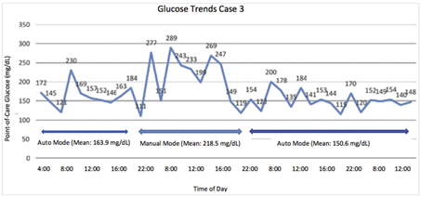
¯Case series: 4 patients all on 670G
Pancreatitis
Lap-Chole
Pneumonia
ERCP

Slide 38
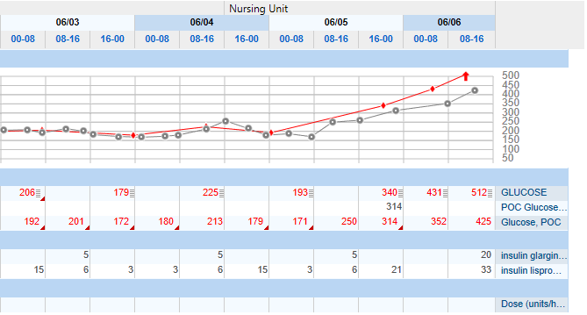
30 y/o admitted with trauma
new to pump therapy
NPO for OR 6/4
Pump occlusion – team not notified
DKA transferred to IMC

Slide 39
Initialization Workflow
Examples of Routine Use
Caution: The iLet bionic pancreas is an investigational device, limited by federal (or United States) law to investigational use

Slide 40
Common Questions from Hospitalist
Do I need to remove CGM for radiology procedures?
Do I need to remove CGM for surgical procedures?

Slide 41
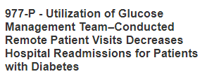
A total of 88 patients were scheduled for post-discharge visits, and 55.7% (n=49) participated in a scheduled telehealth visit, while 36.4% did not (n=32). Of patients who no-showed, there were zero 30 day readmissions and fourteen 90 day readmissions (43.8%)
Of patients who had a telehealth visit, there were two 30 day readmissions (4%) and eleven 90 day readmissions (22.4%). Odds ratio for 90 day readmission was 2.69 (p=0.042) in those who did not attend a post-discharge telehealth visit
Johns A, et al presented ADA Scientific Sessions 2022 New Orleans

Slide 42
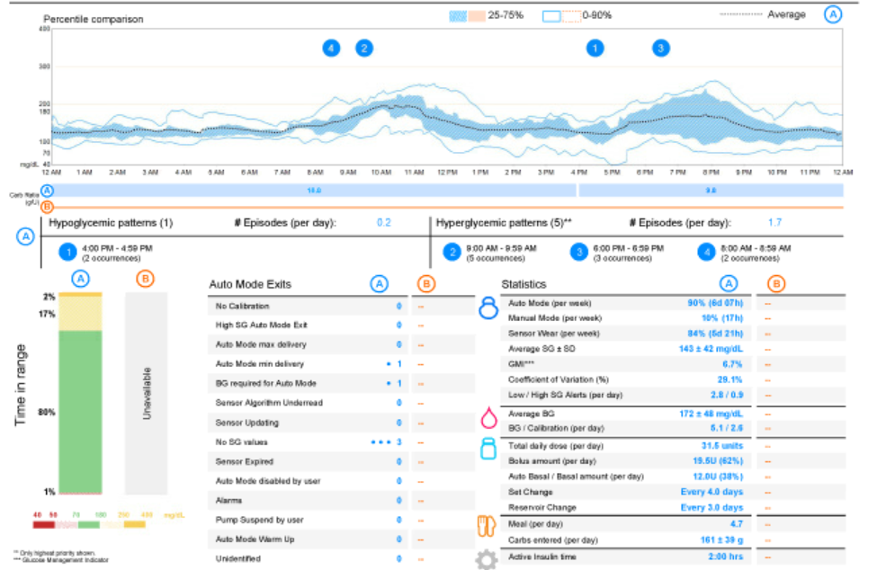
28 y/o college student – attends school New York
Seen with video visit and uploaded pump/sensor data to cloud based data repository

Slide 43
Recently joined Eastern Virginia Med School/Sentara Health
Asked to deploy an Inpatient Glucose Management Project
2009-2014 we
Initiated a Glucose Mgmt Committee
Developed a glucometrics dashboard
Piloted an epic insulin dosing calculator
By 2012 established a culture of “Glucose safety/Insulin respect”
Moved our hypoglycemia rate (#tests <70 mg/dl) from ~4 -2.5 %
Launched an Epic based Glucommander ( rates fell below 1%!)
2014 I arrive at Wake Forest Baptist and I am asked to “develop a GMT”
Our prior Hypoglycemia rate is 2 - 3%
We are 7 months into EndoTool launch

Slide 44
VMC EndoTool Hypoglycemia Summary
Data collected (2008-2013)
Timing | Number of Patients | Glucose Values | Number of Values <40 <60 <70 | Percent of Readings <40 <60 <70
All Glucose values | 8078 | 260,870 | 93 1017 3099 | 0.04 0.39 1.19
Within 15 minutes | 8078 | 260,870 | 61 729 2232 | 0.02 0.28 0.86
Tanneberg et al :USE OF A COMPUTER-GUIDED GLUCOSE MANAGEMENT SYSTEM TO IMPROVE GLYCEMIC CONTROL AND ADDRESS NATIONAL QUALITY MEASURES: A 7-YEAR, RETROSPECTIVE OBSERVATIONAL STUDY AT A TERTIARY CARE TEACHING HOSPITAL Endo Practice 2017

Slide 45
Quality Metrics for Endocrine Obesity and Metabolism Service Line

Slide 46
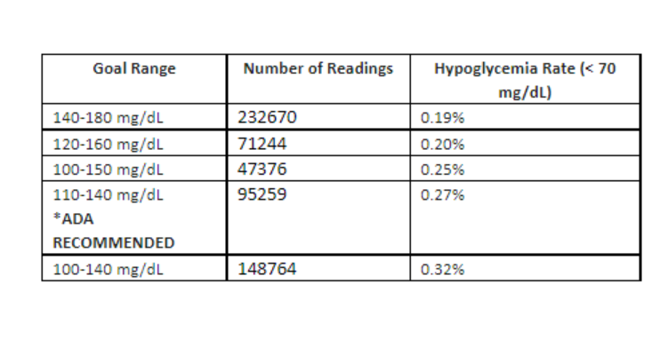
EndoTool Atrium Health Experience

Slide 47
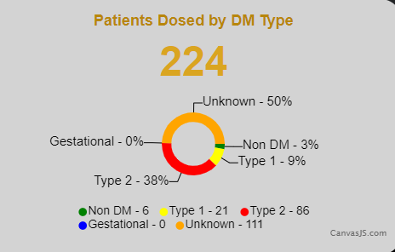
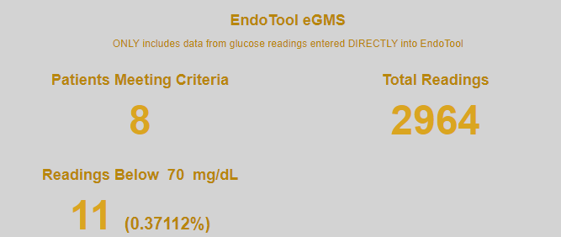
If we exclude “late” BG patients: No BG < 50 mg/dL and .25 % , 70 mg/dL

Slide 48
Technology in Prehab
Patients requiring better BG control prior to elective procedures (elective joint, Chemotherapy)
Quality metrics and elective joint replacement bundles

Slide 49
Frederick: A Case
60 years old, diabetes for 8 years
Obese (BMI 33, wt =100 kg) with non-proliferative retinopathy, normal renal function
Not much exercise; not successful with dietary changes
Needs a TKR – to be able to exercise
Metformin 1g BID, glimepiride 4 mg daily
Sitagliptin 100 mg daily
Current A1c = 9.4%
Home glucose (checks 3-4 times per week)
Fasting : 180-200 mg/dL
Pre-meal glucose : 200-250 mg/dL
Notes:
49

Slide 50
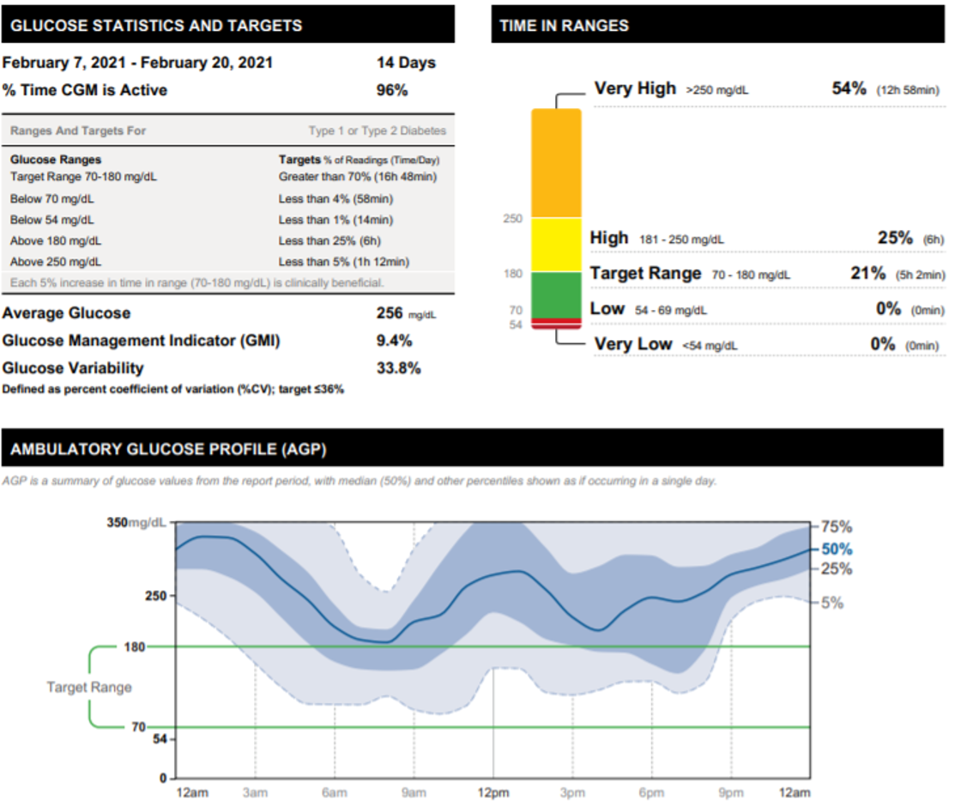

Slide 51
Frederick was started on 0.25 mg semaglutide weekly at bedtime
He gave his first injection in the office before leaving
He was provided with a self-titration schedule
He was seen within the 3 weeks by a provider in the practice (PHARM D)
CGM demonstrated Average BG now ~100 – at goal
A1c unchanged
At his 3 month visit:
A1c = 6.4%
FPG= 115-135 mg/dL
Notes:
51

Slide 52
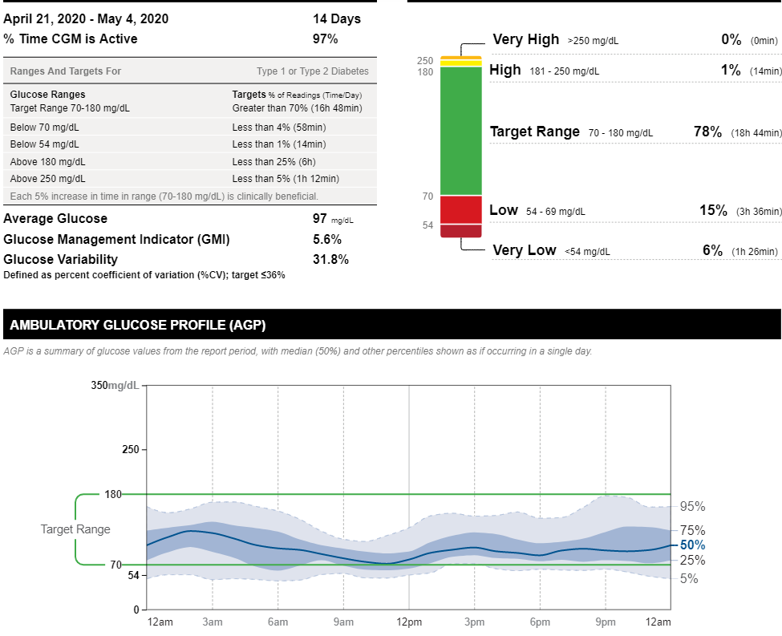
Ortho wants A1c <7% and BMI <30 kg/m2

Slide 53
SUMMARY
CGM can assist in identifying behaviors that are barriers to care
CGM can minimize therapeutic inertia
Remote patient management can be effective when combined with glucose data provided by CGM
CGM can minimize need for POC BG testing

